Slide 1
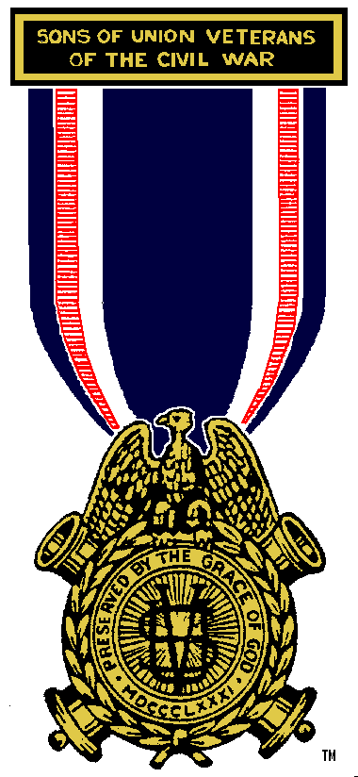
What Is The Sons of Union Veterans of the Civil War?

Slide 2
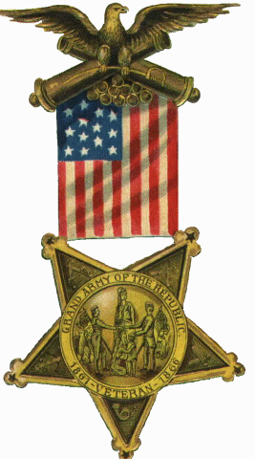
The SUVCW is a volunteer, non-profit, patriotic & educational organization similar to the Grand Army of the Republic (GAR) and is officially recognized as the GAR’s legal successor.

Slide 3
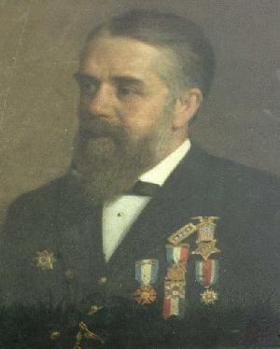
Founded in 1881 by sons of Civil War Veterans, the SUVCW today has over 6,000 members.
Augustus Plummer Davis Father & Founder SUVCW

Slide 4
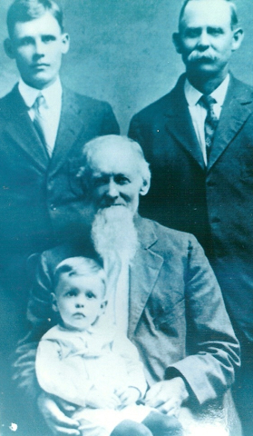
Membership Eligibility
Male descendants of soldiers, sailors, or marines who served in the Army or Navy of the United States of America during the War of the Rebellion of 1861 to 1865.

Slide 5
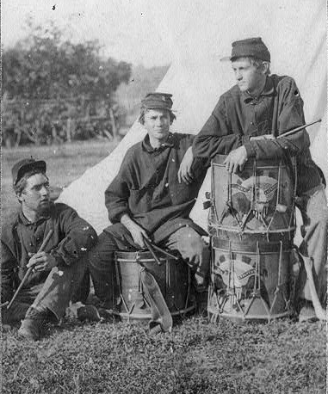
Additionally, those who do not have the ancestry but who demonstrated a genuine interest in the Civil War, may join as Associates.

Slide 6
Our Mission
Honor Union Veterans
Preserve & Perpetuate GAR
Patriotic Education

Slide 7
Honoring Union Veterans
The SUVCW cooperates in doing honor to all who have patriotically served our country in any war. The order participates with other patriotic organizations in the proper observance of our national holidays; discovers and marks the graves of Civil War veterans; oversees the care and upkeep of Civil War memorials and brings any failure to do so to the attention of the proper responsible parties.

Slide 8
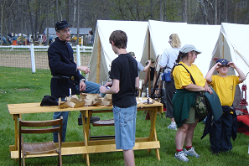
Patriotic Education
The SUVCW's patriotic education includes teaching Patriotism, the duties of citizenship, the true history of our country, and the love and honor of our flag. We also assist in the proper teaching of American history in our schools

Slide 9
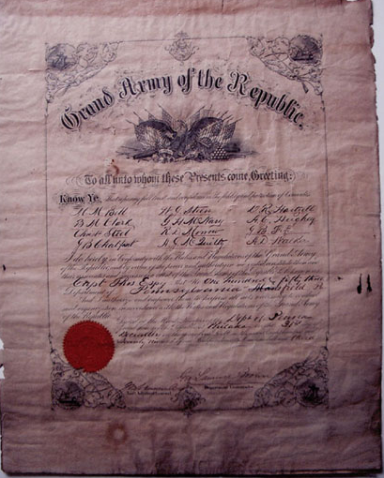
Preserving and Perpetuating the GAR
The SUVCW assists in the
preservation of and in providing
availability for research, the
documents and records
pertaining to the Grand Army of
the Republic and its members.
Meetings and Encampments
are conducted according to the
tradition and rituals of the GAR.

Slide 10
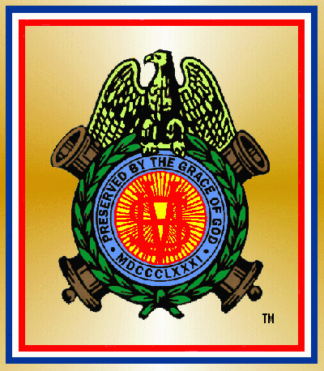
Sponsored by the SUVCW a 501(c)(4) organization approved by the U.S. Internal Revenue Service as an organization to which tax deductible gifts can be made pursuant to Section 170 of the Internal Revenue Code.

