Slide 1

Purpose of the
Sons of Union Veterans of the Civil War

Slide 2
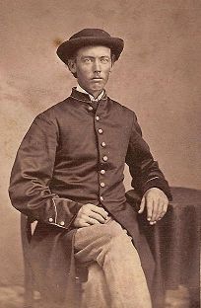
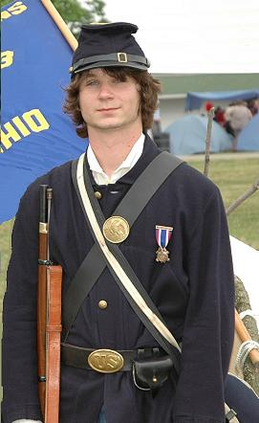
Preserve and Perpetuate the Grand Army of the Republic and their sacrifice for the maintenance of the Union

Slide 3
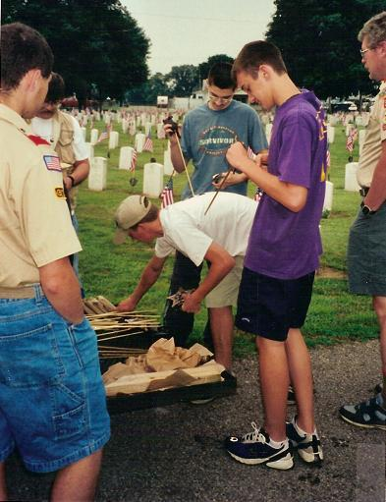
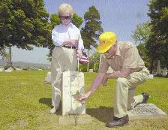
Ensure the proper observance of Memorial Day

Slide 4
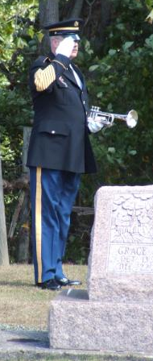
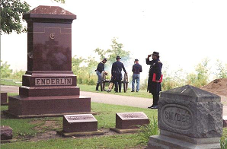
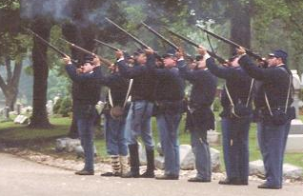
Honor Union Veterans

Slide 5
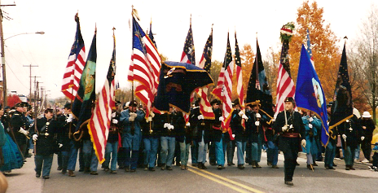
Union Veterans are honored by members participating as honor guards, master of ceremonies, and in parades.

Slide 6
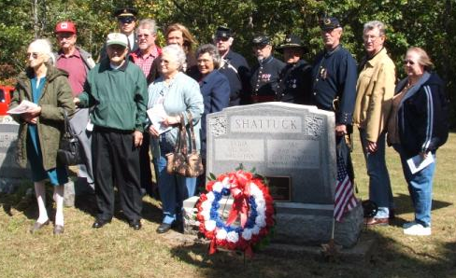
The Last Union Civil War Veteran Project’s goal is to mark the final resting place of the Last Union Civil War Veteran of each county and parish in the US

Slide 7
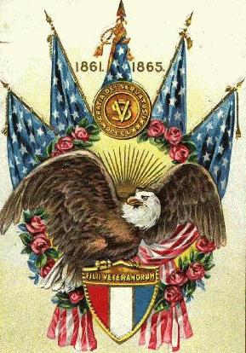
To aid and assist worthy members of our order

Slide 8
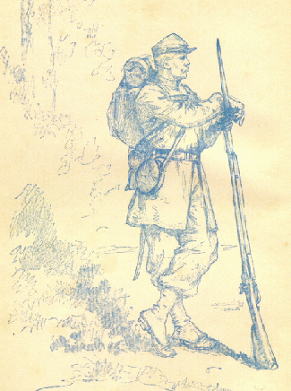
To inculcate patriotism
& love of country and spread & sustain the doctrine of equal rights, universal liberty
& justice to all.

Slide 9
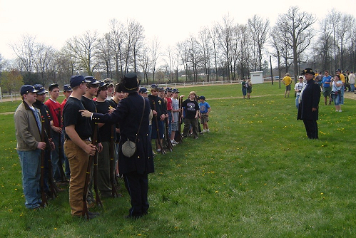
Through living history presentations members provide patriotic education to the community.

Slide 10
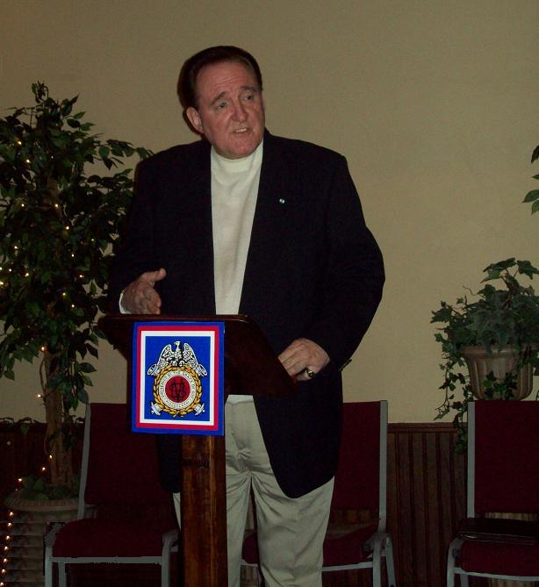
Members discuss the
Civil War
and related
topics to various community organizations.

Slide 11
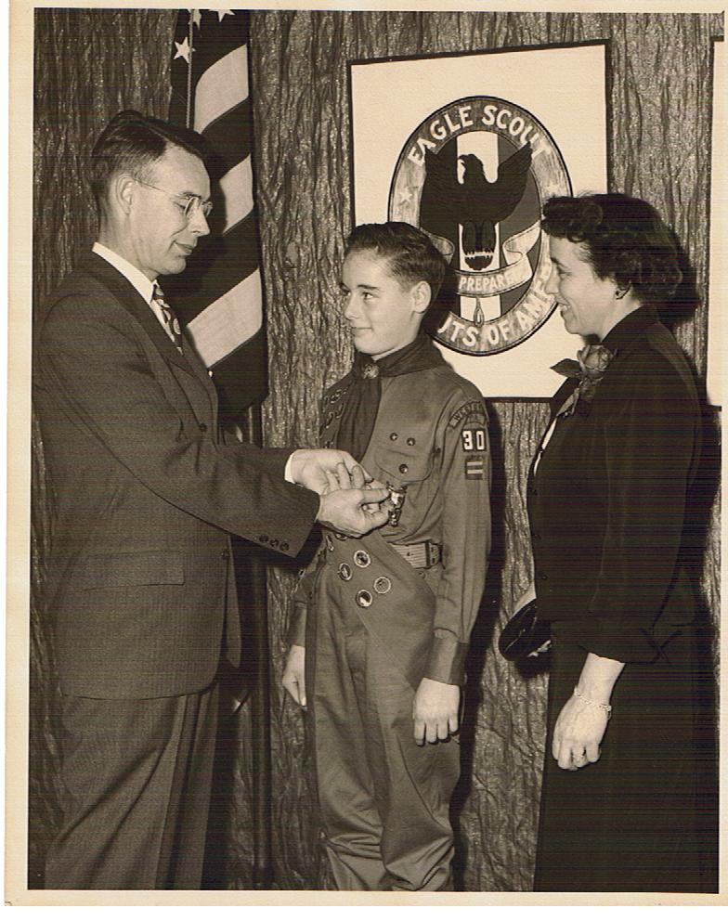
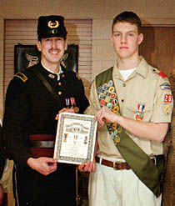
Patriotism is encouraged by providing awards for youth leaders in ROTC & Scouting programs

Slide 12
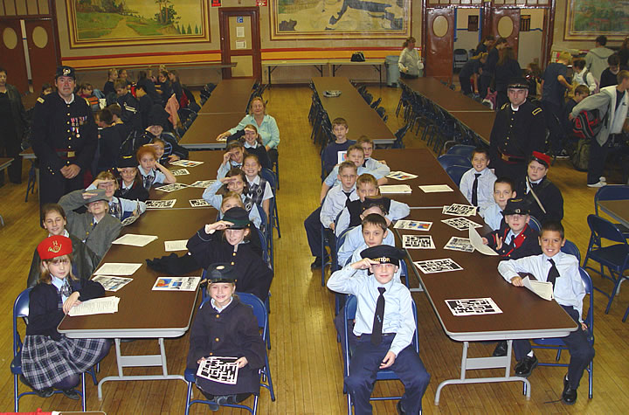
Civil War Education is provided to area schools.

Slide 13
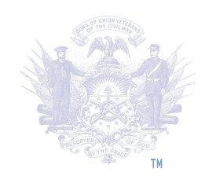
Sponsored by the Sons of Union Veterans of the Civil War
http://www.suvcw.org

