Slide 1
1861
Civil War Begins

Slide 2
January 1861
The South Secedes
Lincoln, an opponent of slavery, was elected president. South Carolina perceived a threat.
State convention delegates voted to remove the state from the union of the United States .
South Carolina seceded followed by Georgia, Texas, Florida, Alabama, Mississippi, and Louisiana.

Slide 3
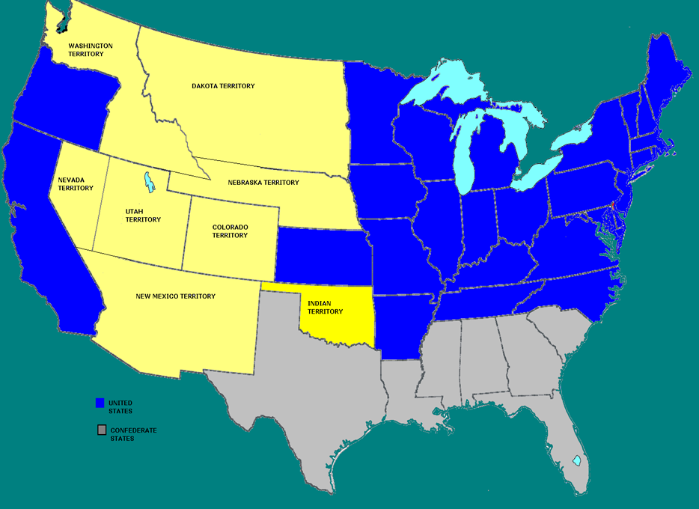
South
Carolina
Alabama
Georgia
Texas
Mississippi
Louisiana
Florida

Slide 4
February 1861
The South Creates a Government
Seven seceding states create Confederate Constitution. Similar to U S Constitution.
Places greater stress on autonomy of states.
Jefferson Davis named provisional president of the Confederacy until elections are held.

Slide 5
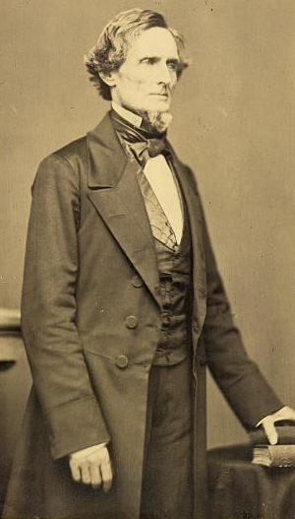
February 1861
The South Seizes Federal Forts
At Fort Sumter, South Carolina troops repulsed a supply ship
The ship was forced to return to New York, its supplies undelivered
Jefferson Davis

Slide 6
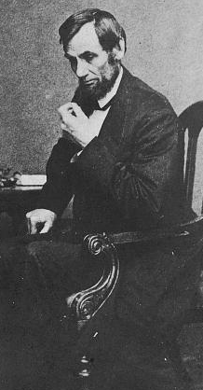
March 4, 1861
Lincoln's Inauguration
Lincoln said he had no plan to end slavery in states where it existed
He would not accept secession
He hoped to resolve the national crisis without warfare

Slide 7
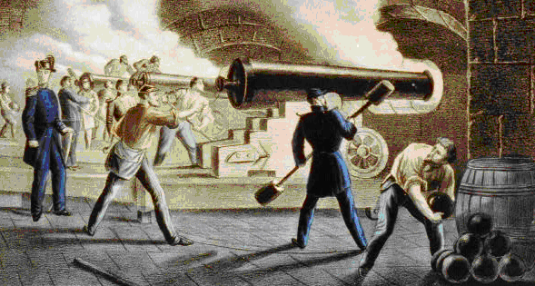
April 12, 1861- Attack on Fort Sumter
Lincoln alerted South Carolina of plans to supply Fort Sumter, SC feared a trick.
April 12, Civil War began with shots fired on the fort. Fort Sumter eventually surrendered.

Slide 8
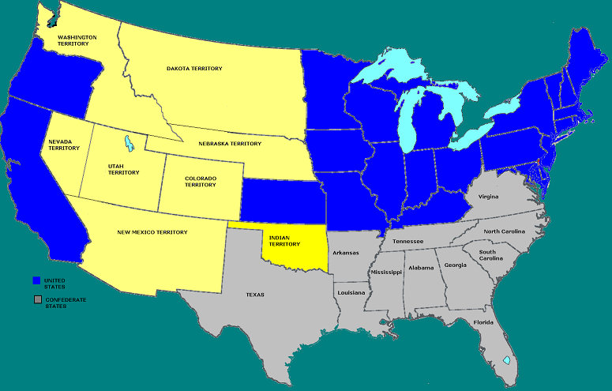
April 1861
Virginia
North Carolina
Tennessee
Arkansas
Four More States Join Confederacy; Tennessee, Arkansas, Virginia & North Carolina

Slide 9
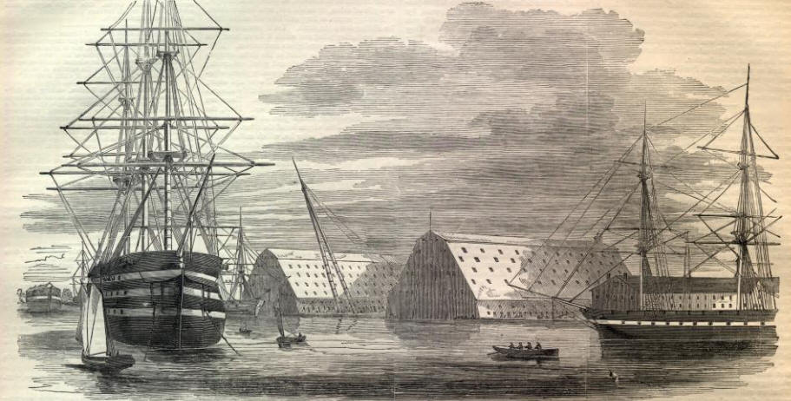
Capture of Gosport Naval Yard
18 April, Virginia Militia appear ready to take Gosport Naval Yard, Portsmouth, Virginia.
USS Merrimack, one of the Union Navy’s most powerful vessels, was in dry dock under repair.

Slide 10
Burning of the USS Merrimack
When it became obvious that the ship could not be made seaworthy the Union officer commanding the shipyard had her scuttled and burned
Later the Confederacy would rebuild the Merrimack and rename her the Virginia

Slide 11
Harper’s Ferry
The Union Arsenal at Harper’s Ferry was a prize the Virginia Secessionists desired.
Turner Ashby commanding 360+ men waited for orders 4 miles from the Arsenal.
He feared Federal reinforcements were en-route and the time to act was now.
Union Arsenal Commander First Lieutenant Roger Jones, ordered arsenal & its 15,000 muskets destroyed upon word of enemy’s nearness.

Slide 12
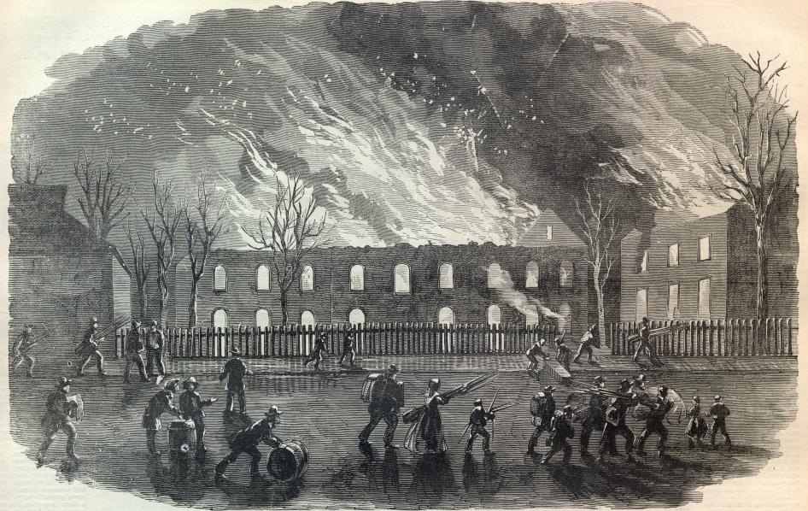
Harper’s Ferry Falls to Confederacy
VA Militia secure town, but arsenal had been leveled.

Slide 13
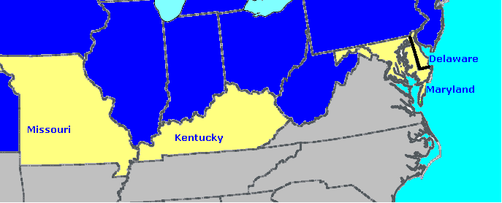
June 1861
Four Slave States Stay in the Union
Political maneuvering & Union military pressure kept Delaware, Kentucky, Maryland & Missouri from seceding.

Slide 14
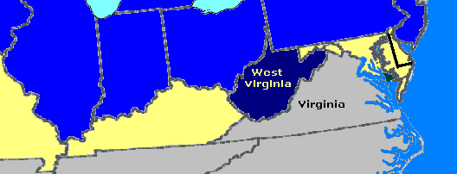
June 1861 West Virginia Born
Residents of western counties of
Virginia did not wish to secede
This area was admitted to the Union as
the state of West Virginia in 1863

Slide 15
Civil War
Eastern Theater
1861-63

Slide 16
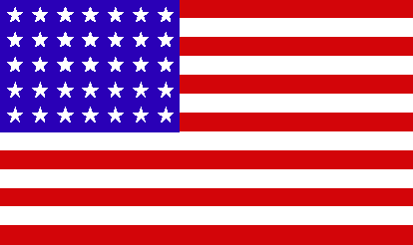
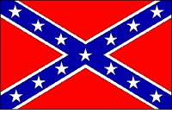
Union Goals:
-Capture the Confederate Capital of Richmond, Virginia.
-Blockade the South to stop trade
Southern Goals:
-Protect Richmond
-Wear out the North
-Take the battle to the North
-Get help from Europe

Slide 17
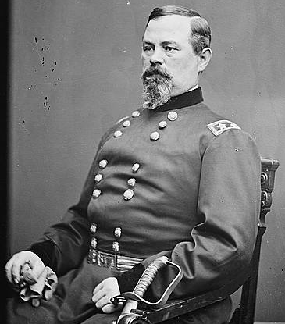
July 1861
First Battle of Bull Run
Public demanded an attack on the South.
General Irvin McDowell
advanced on Confederates with
in-adequately trained troops
McDowell initially successful,
until Confederate reinforcements
arrive, resulting in a Southern
victory.

Slide 18
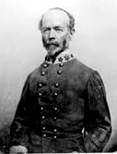
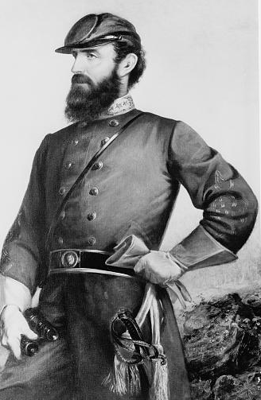
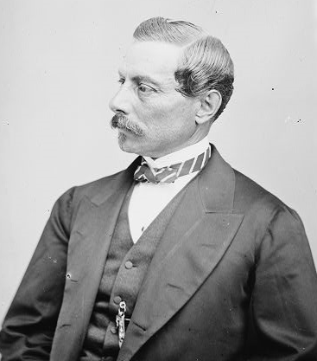
Bull Run Southern Generals
Joe Johnston Pierre GT Beauregard
“Stonewall” Jackson
Stops Union advance earning his nickname

Slide 19
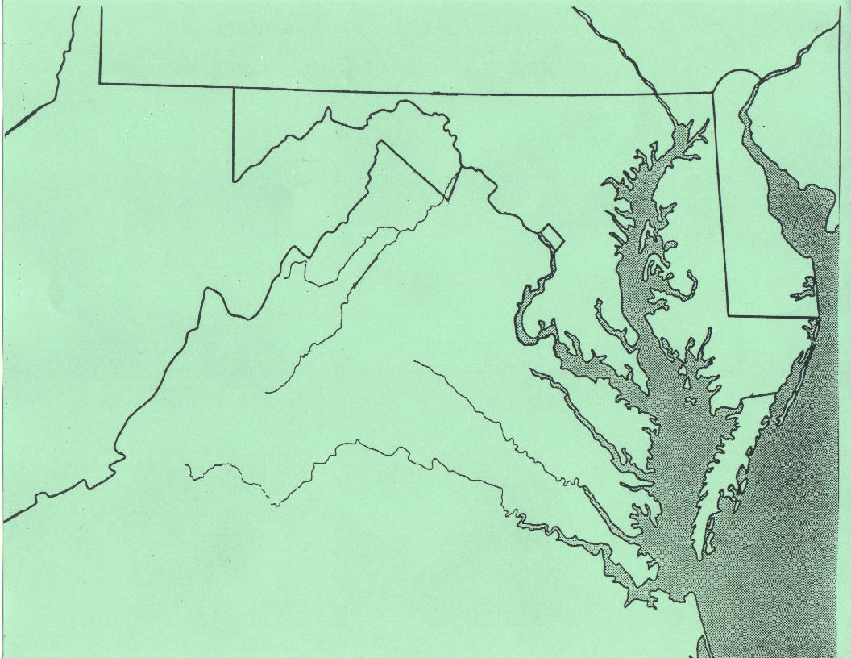

East
Jackson
Harper’s Ferry
*Washington, DC
1st Battle Bull Run
Joe Johnston
Pierre GT Beauregard
* Richmond, VA

Slide 20
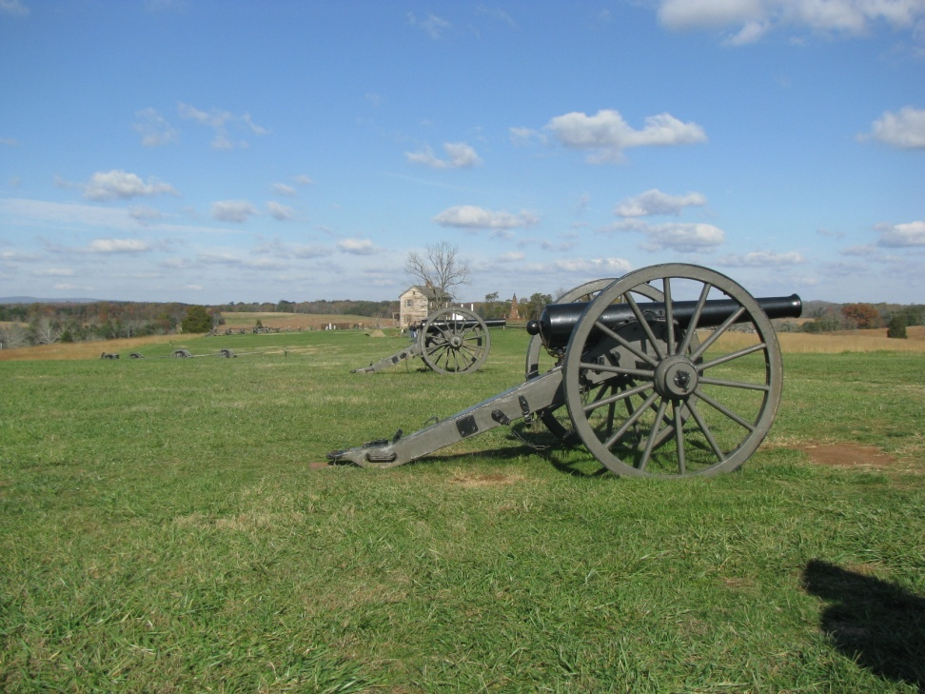
The Battle
Main battle centered around Henry Hill, occupied by General Thomas Jackson’s Virginia troops.
Jackson defended against the 14th Brooklyn’s series of attacks & he gave the 14th their nickname, “Red Legged Devils” because of their relentless charges.
Henry House Hill as it appears today Photo by Brother Mark Day

Slide 21
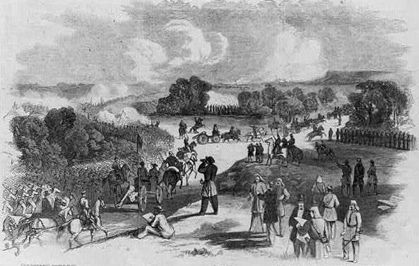
Many civilians that had come to watch the battle were sent fleeing back to Washington DC in a panic; disrupting the Union retreat.

Slide 22
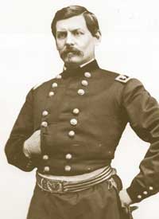
July 1861
General McDowell Is Replaced
Aware of the army's need for organization and training, Lincoln replaced McDowell with General George B. McClellan.

Slide 23
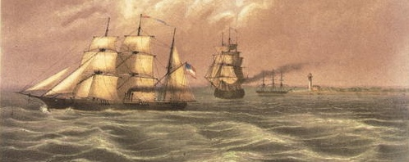
July 1861
A Blockade of the South
The federal Navy established an effective blockade of the Confederate coast.
The South responded by building small, fast ships that could outmaneuver Union vessels.

Slide 24
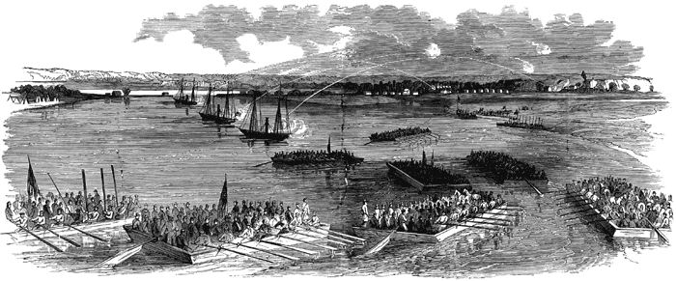
Port Royal, South Carolina November 1861
Captain Dupont's warships silenced guns in Confederate Forts Walker & Beauregard.
General Thomas W. Sherman's troops occupy the Sea Islands of South Carolina.

Slide 25
Civil War
Western Theater
1861-63

Slide 26
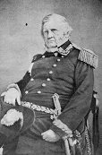
Union Goals
Capture Mississippi River :
1. Divide the South
2. Complete Naval Blockade
3. Close Southern Ports
Nicknamed General Scott’s Anaconda Plan

Slide 27
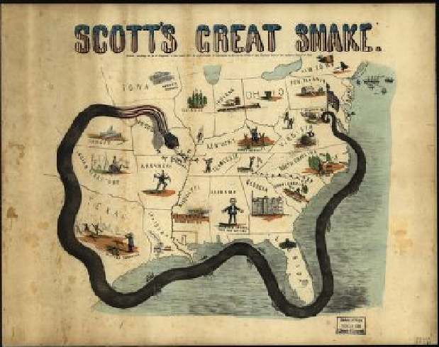

Slide 28
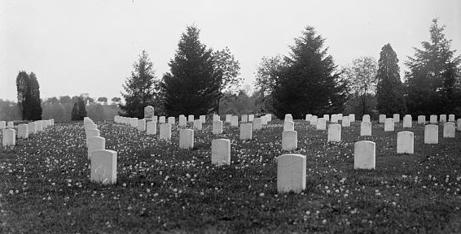
Both sides finally realized that the war was far from over.
It would last 4 years claiming over 600,000 lives.

Slide 29
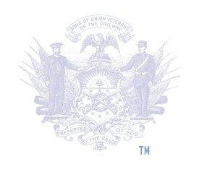
Sponsored by the Sons of Union Veterans of the Civil War http://www.suvcw.org

